Slide 1

PHASE
Blueprint for Transformational Change
A Technical Assistance 2.0 Progress Report
Where are we?

Slide 2
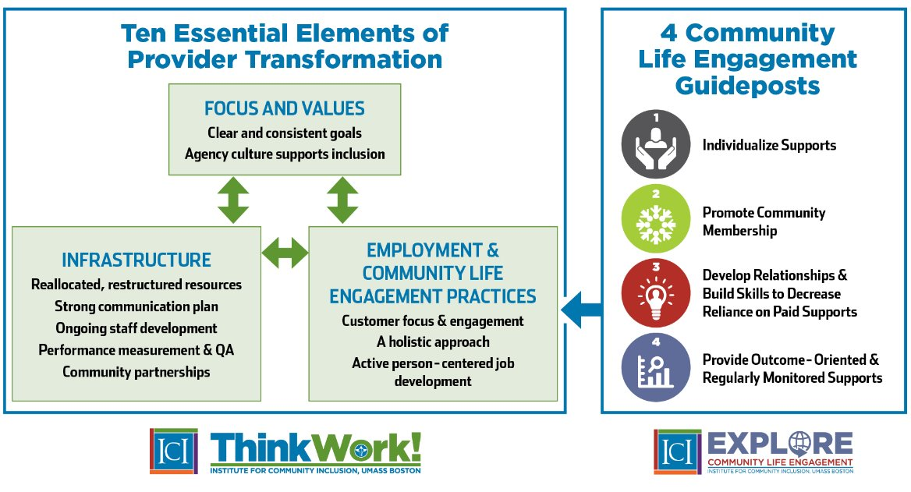

Slide 3
PHASE Transformation Activities
Clear and Consistent Goals
Strong Company Culture Supporting Inclusion
Focus & Values
Transformation Business Plan
MTI TA 1.0 Plan
“Closed door policy” implemented
PHASE drops 14 c
Company-wide retreats
Written “Why” Statement
PHASE Video “Why Change?”
MTI TA Plan 2.0
Staff Training on Mission & Values, Transformation, & Code of Ethics
BHAG: 100 Jobs by 2026—broken down by location and quarter
40 Mentors trained by 2026
Clear & Consistent Goals
Company Culture Supports Inclusion
Bucket 1

Slide 4
PHASE Transformation Activities
Infrastructure
Transformational, Strategic Business Plan
Organizational Merger with Advance Opportunities
Restructuring of Management & Staffing Roles
Breaking down Employment & Day Service Silos
Reallocating Financial & Staff Resources
Reformatted Job Description and Tiers
Reallocated, Restructured Resources
Strong Communication Plan
Ongoing Staff Development
Performance Measurement & QA
Community Partnerships
Rebranding & New Company Communication Plan
Pathways to Competency: Staff Development Plan
Internal Staff Development Program--Denise
Innovations Grant Mentoring Program--DHS
Ongoing CoP & Quarterly Trainings—Topical
Middle-Manager Training (L & M course)
Purchase of SETWorks Data Management System
New Data Collection & Outcome Process: Collaboration with MN MAD/PHASE/MTI Data
Grand Reopening Event
New & Refreshed Business Partnerships
New & Refreshed Community Partnerships (CLE)
Bucket 2

Slide 5
PHASE Transformation Activities
Rebranding of Communication Messaging
Community of Transformation Business Plan with All Key Stakeholders (BODs, Staff, Business Leaders, Funding Agencies, others)
Updating of contract agreements with governmental agencies, business leaders, others
Employment & Community Life Engagement Practices
Customer Focus & Engagement
A Holistic Service Approach
Active, Person-Centered Employment Development
Adoption of Person-Centered Planning Tools, Practices (e.g., Discovery, Other)
Implementation of E1MN Engagement Practices (CIE Exploration & Informed Choice)
Adoption & Integration of CIE and CLE outcomes
Implementation of High Support Needs Pilot (HSN)
Community Life Engagement CoP participation
Restructuring of Staff Roles, Duties, & Expectations
Increasing staff skills and capacities to deliver CIE/CLE outcomes at all locations
Robust staff development training (Employee onboarding, Internal Mentor Grant Objectives, MTI, online training—DirectCourse, etc.)
Advanced training to develop CIE (i.e., certification in Discovery & Customized Employment, CESP)
Bucket 3

Slide 6
A Snapshot: PHASE-Industries' Transformational Journey So Far
Outcomes
Infrastructure Focused Changes
Staff Focus
Communication Planning
PHASE's "Why"
Jobs and connections
Then: Build Infrastructure
Now: Focus on Outcomes
Refine infrastructure pieces that connect directly to outcomes and do the work!

Slide 7


Slide 8
Outcomes
In this Quarter (April 1-June 30, 2025)
100 Jobs by June 30, 2026
Quarter Ending Mar 31, 2025: |  | Quarter Ending June 30, 2025
Total: 7 | Goal: 8 | Total | Goal: 14
Mora: 0 Pine City: 1 Cambridge: 3 Sandstone: 1 Marshall: 2 | Mora: 1 Pine City: 1 Cambridge: 3 Sandstone: 1 Marshall: 2 | Mora: Pine City: Cambridge: 2 Sandstone: Marshall: | Mora: 2 Pine City: 3 Cambridge: 4 Sandstone: 2 Marshall: 3
Running Totals: June 1, 2025- June 30, 2025
Total: 21 | Goals: 32 33? | Variance: | % of BHAG Achieved
Mora: 2 Pine City: 2 Cambridge: 9 Sandstone: 1 Marshall: 7 | Mora: 3 (4) Pine City: 3 (4) Cambridge: 12 (13) Sandstone: 4 (3) Marshall: 10 | Mora: Pine City: Cambridge: Sandstone: Marshall: | 21%
Jobs & Connections

Slide 9
Outcomes
In this Quarter (April 1-June 30, 2025)
180 Completed Discovery Profiles with realized CLE outcomes by June 30, 2026 (30 per quarter=150)
Quarter ending Mar 31, 2025 |  | Quarter ending June 30, 2025
Mora: Pine City: Cambridge: Sandstone: Marshall: Total: __ | Goal: Complete process for completing Discovery Profile | Mora: Pine City: Cambridge: Sandstone: Marshall: Total: | Mora: 6 Pine City: 6 Cambridge: 6 Sandstone: 6 Marshall: 6 Goal: 30
40 staff completing the Mentor Program by June 30, 2026 (Completion of program takes 8-10 weeks)
Quarter ending March 2025: |  | Quarter ending June 2025
Mora: 0 Pine City: 0 Cambridge: 0 Sandstone: 0 Marshall: 0 Total: 0 | Goal: Complete development of curriculum and metrics | Mora: Pine City: Cambridge: Sandstone: Marshall: Total: | Mora: 1 Pine City: 1 Cambridge: 1 Sandstone: 1 Marshall: 1 Goal: 5
Jobs & Connections

